Slide 1



High-Altitude Drone Navigation
Team DASA

Slide 2






Team Intro
Santiago Dorado
Senior
Computer Engineering
Devin Hill
Junior
Computer
Science
Ayia Ismael
Junior
Computer Engineering
Adrian Whitty
Sophomore
Computer
Science

Slide 3
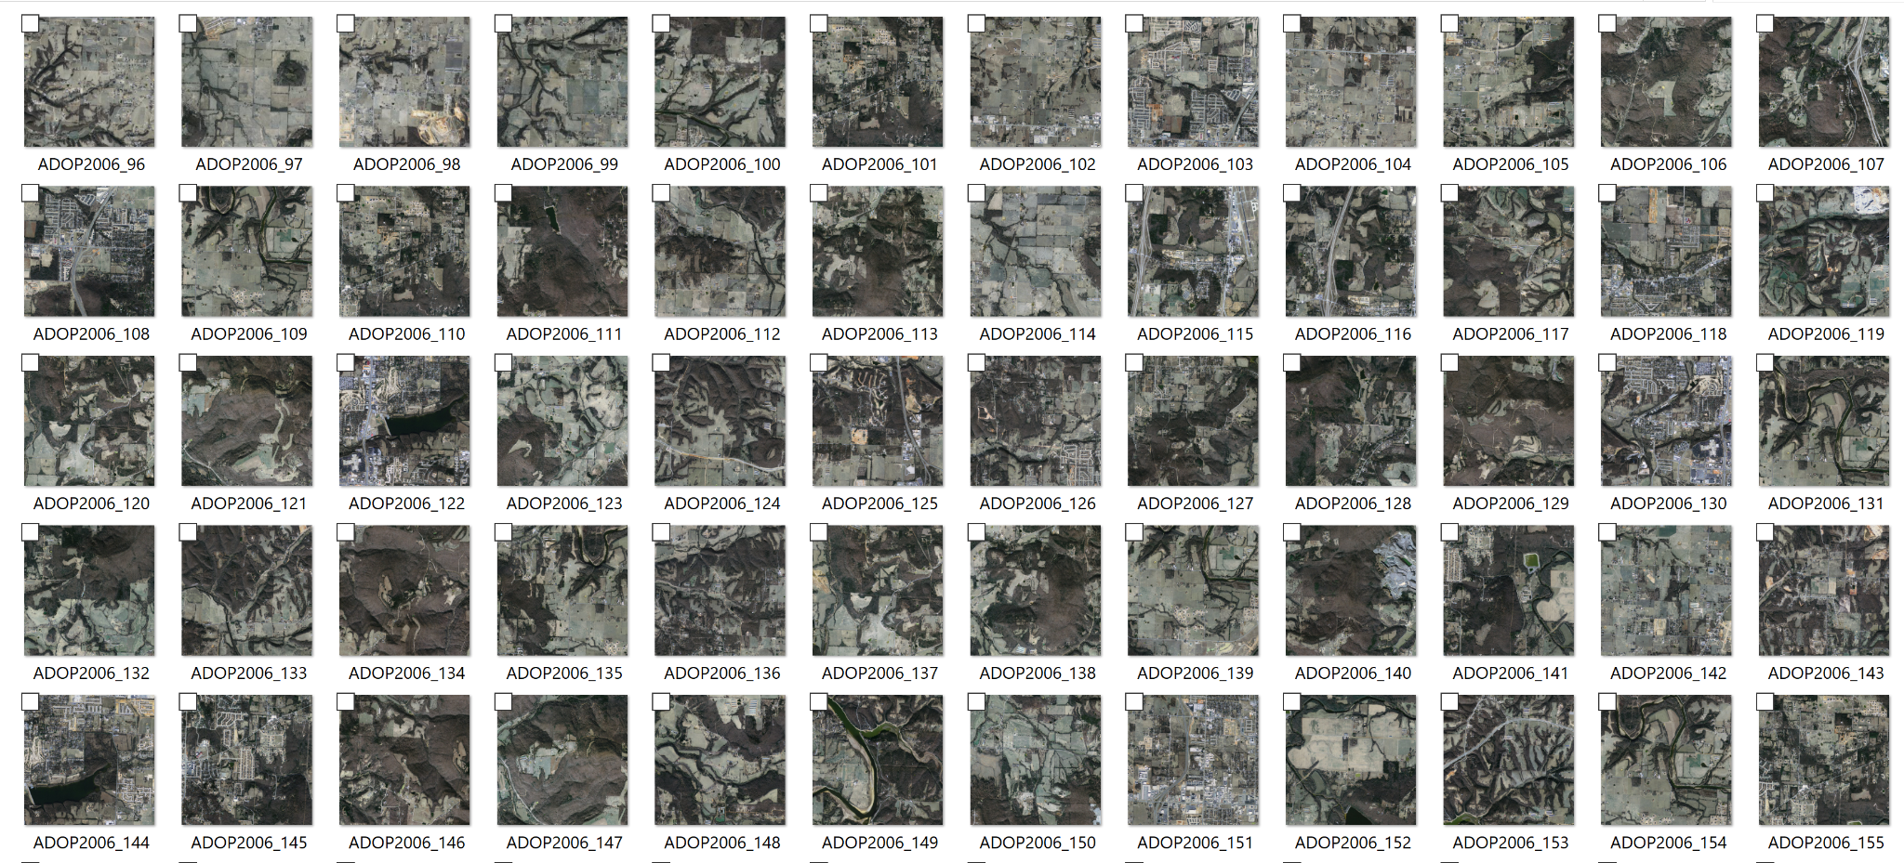
PROCESS
Building the pre-processing pipeline for image information
Bounds were created with size restrictions for the training set of images
Infrared images were removed
Scaling and mapping images
Worked on improving the RMSE and Accuracy of the following models and submodels:
Xception
Distribution Runner
ViT(Vision Transformer)
Adam
Adam w/ Weight Decay
Notes:
Adrian
We started of with data given to us by Wint a graduating Ph.D student and Dr. RainWater.
The process of making this project included Building the pre-processing pipeline for image information and with that we created bounds with size restrictions for the training set of images, we also removed infrared images and scaled and mapped the images
The second thing we worked on was increasing the accuracy and we did that by using the models Xception and Vit, the submodels that we used were distribution runner ,Adam and Adam w/ weight decay.

Slide 4
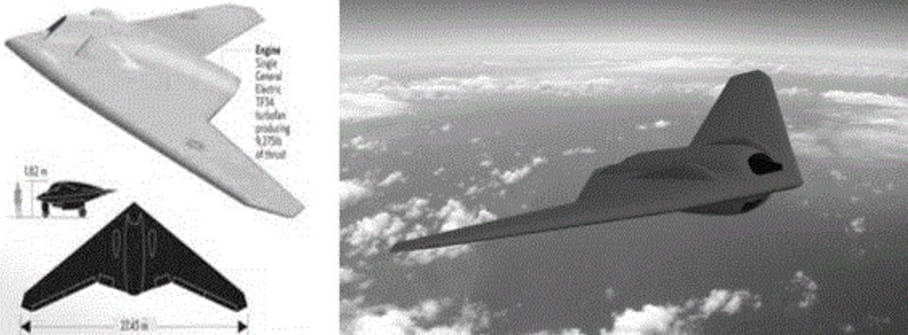
DRONE NAVIGATION
Drones use satellite navigation to determine their location.
With advancements in technology, the satellite signal that the drone receives are susceptible to be spoofed.
Notes:
Ayia
Before we dive in, let me give you guy some context on the current state of drone navigation,
Drones use satellite navigation to determine their location.
and are generally equipped with small cameras so that they can be navigated around obstacles on various terrain.
With advancements in technology, the satellite signal that the drone receives are susceptible to spoofing, which is a form of interference which makes the drone believes it is at a false location usually done using a nearby radio transmitter.
This then leads to the “why” of our project, to circumvent both natural interference(reflection, and inclement weather) and artificial interference (like spoofing) we can’t solely rely on the more traditional methods of navigation (global navigation satellite system/gps)

Slide 5

TERMINOLOGY
Geolocalization
the process of determining or estimating the geographic position of an object.
Visual Localization
to estimate the camera pose of a given image relative to a visual representation of a known scene (2)
Absolute Visual Geolocalization
to locate the current view of the UAV in a reference satellite map or georeferenced imagery from previous flights (3)
Notes:
Adrian
Some terminology to help you understand our project includes geolocalization, visual localization and absolute visual geolocalization.
Geolocalization is the process of determining or estimating the geographic position of an object.
Visual localization is to estimate the camera pose of a given image relative to a visual representation of a known scene
Absolute visual geolocalization is locating the current view of the UAV in a reference satellite map or georeferenced imagery from previous flights

Slide 6
ViT (Vision Transformer)
The Vision transformer is based on the structure of a transformer designed for text-based tasks.
Vision Transformers divide images into patches at a fixed size and then positionally embeds them, to then be used as input to the transformer encoder.
For this Project, we used vision transformers in our “AdamW” model. We take in an aerial drone image, then split the image up into patches. Therefore our 24,000 images will all be patched which will give us more data for our model since vision transformers are optimal for large datasets.
Notes:
Santi

Slide 7

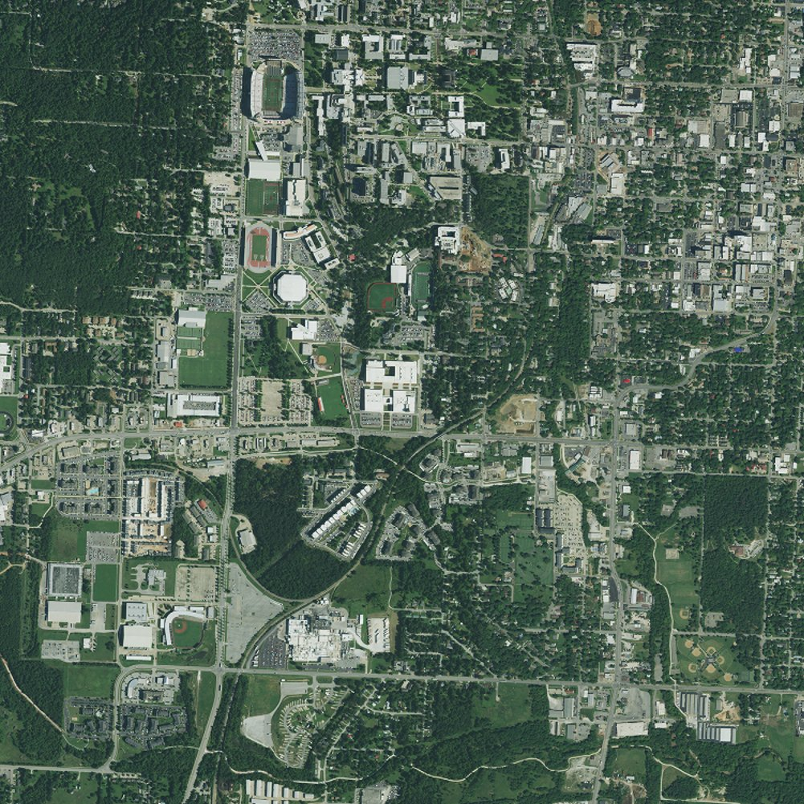
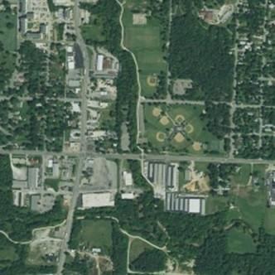
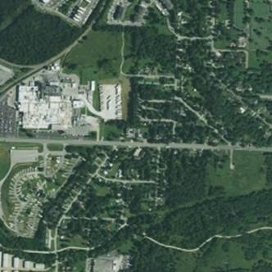
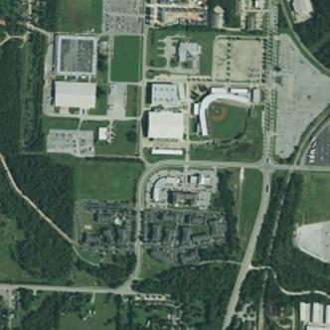
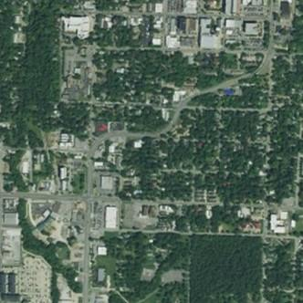
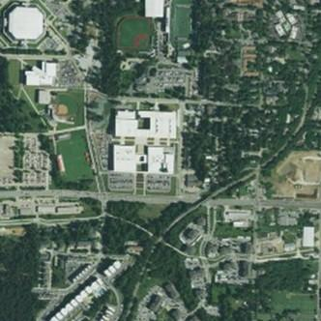
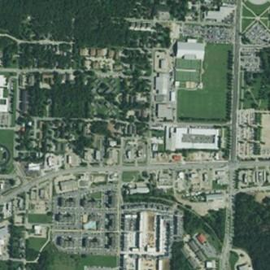
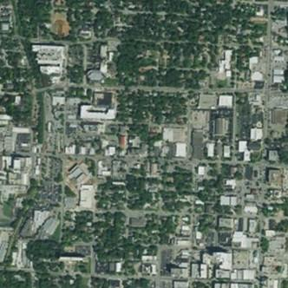
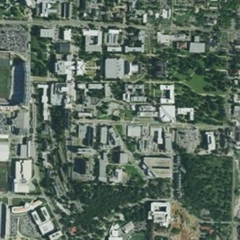
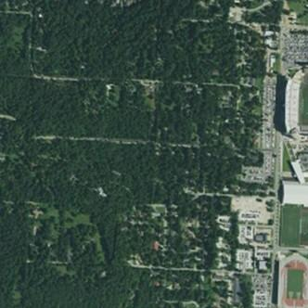
Transformer
Encoder
Class
Vision Transformer (ViT)
MLP Head
Step 5
+
Transformer Encoder
MLP
Step 4
Norm
0
1
2
3
4
5
6
7
8
9
Step 3
+
Linear Projection of Flattened Patches
Step 2
Multi-Head Attention
Patch & Position Embedding
Norm
Step 1
Embedded Patches
Notes:
Santi

Slide 8
ADAMW using Vision Transformers
AdamW is a modified version of the Adam’s stochastic optimization algorithm with built-in weight decay that is independent of the algorithm's adaptive per-parameter learning rates.
Changes:
Number of epochs, initial learning rate, added dense and dropout layers, number of layers, patch size, and model dropout rate.
Result/Conclusion:
Decreased RMSE by 75.3% from the base model, increased categorical accuracy by 1.68 points, and decreased loss substantially
Notes:
Santi

Slide 9
XCEPTION
Xception is a convolutional neural network. That is 71 layers deep. Categorize location of images.
The issue with Xception is that it was designed for ground level classification.
The Xception model was then changed to model outputs of a normal distribution.
Xception model out performed several other models.
Notes:
Devin
The pretrain Xception network can classify 1000 object categories, but in our class we are using Xception to categorize location of images.
Issue add point: Although is was our most optimal model it was still underdeveloped for aerial geolocalization.
Changes: Characterizing the location estimate, with the loss function set to negative log-likelihood.
Results: But with limited time and resources a few architectures were only able to be tested with a larger dataset.

Slide 10
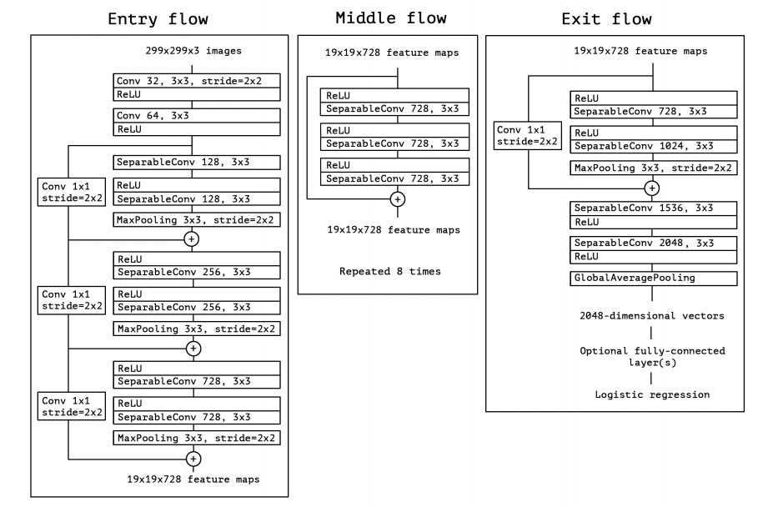
XCEPTION MODEL LAYERS
Notes:
Devin
36 Convolutional Layers
The data first goes through the entry flow, then through the middle flow which is repeated eight times, and finally through the exit flow.
All Separable Convolution layers use a depth multiplier of 1 (no depth expansion).

Slide 11
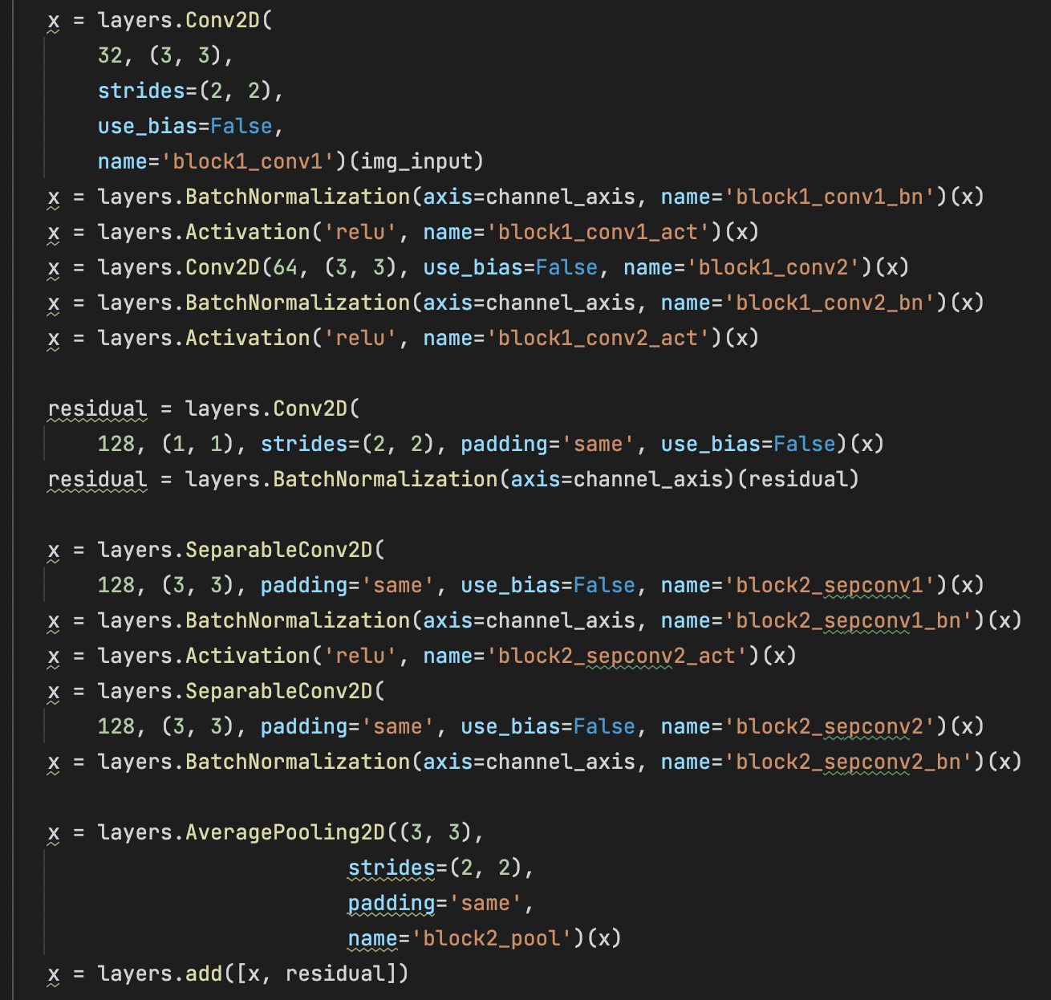
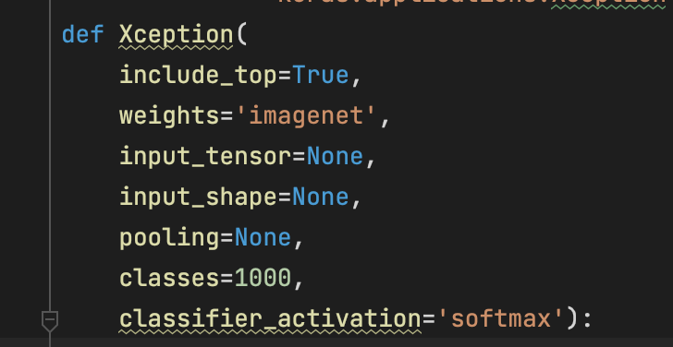
XCEPTION CODE BLOCKS
Notes:
Devin

Slide 12
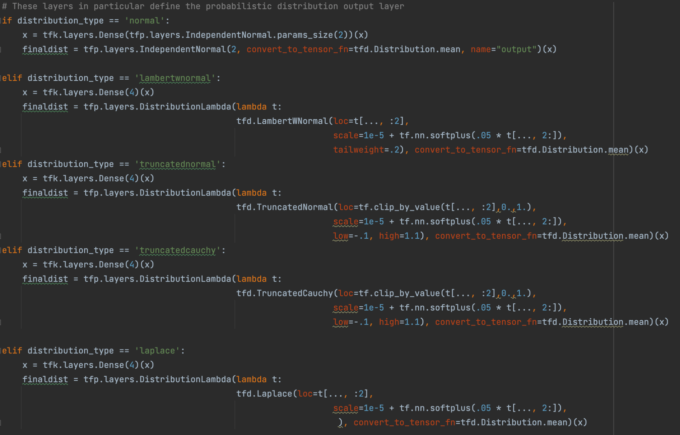
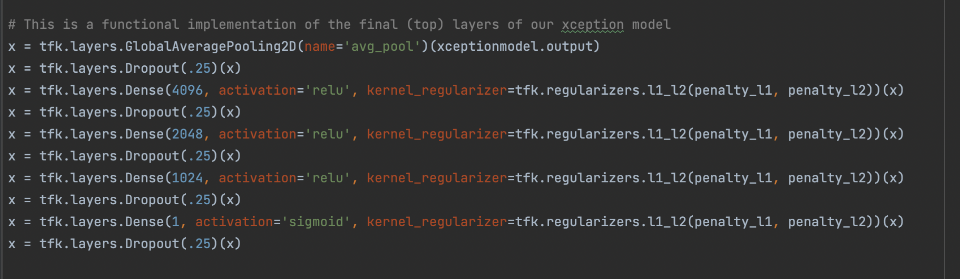
DISTRIBUTION RUNNER CODE BLOCKS
Added Layers
Distribution Argument
Notes:
Ayia
The “Distribution Runner” is an Xception model that implements an interchangeable layer distribution type, with more layers than just the Xception model alone.
Elif, if statements for distribution output layer

Slide 13
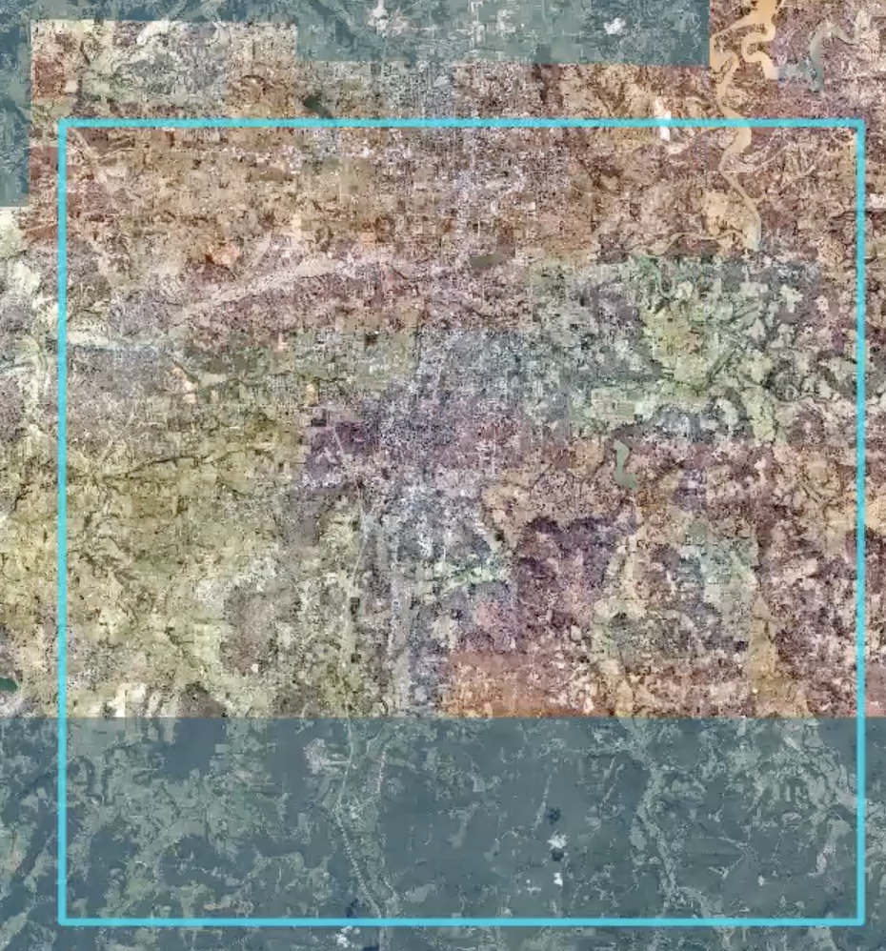
SURVEYED AREA
30 kilometer by 30 kilometer area in Washington County
Images from these regions are from 2006 to 2020
Notes:
Adrian
The surveyed area that we used for this project was taken in washington county and mostly covered agricultural land, the images were taken from 2006 to 2020.

Slide 14

OBSTACLES
Implementing the required packages onto our personal computers
Model used is optimized to use large datasets
Resolving project issues within our limited time
Notes:
Devin/Ayia
Implementing the required packages onto our personal computers
Most of us were using Mac OS, and the program and packages were designed on Windows so some of the base code error’d on us due to memory/package version issues.
Lack of data available
The data that we used for this project included 24,000 images from a 30 km x 30 km area in Northwest Arkansas. The problem with this, is due to Vision Transformer models being optimal for larger datasets.
Additionally, large, pre trained deep learning models for aerial imagery feature detection do not currently exist so the models must be fully trained from scratch.
Time Constraint
We couldn’t upload and run on a high performance high computing center due to the amount of time spent on setting up our environments, computing center account problems, and incompatible dependencies from the original program, all of which would have allowed stronger accuracies due to better training

Slide 15
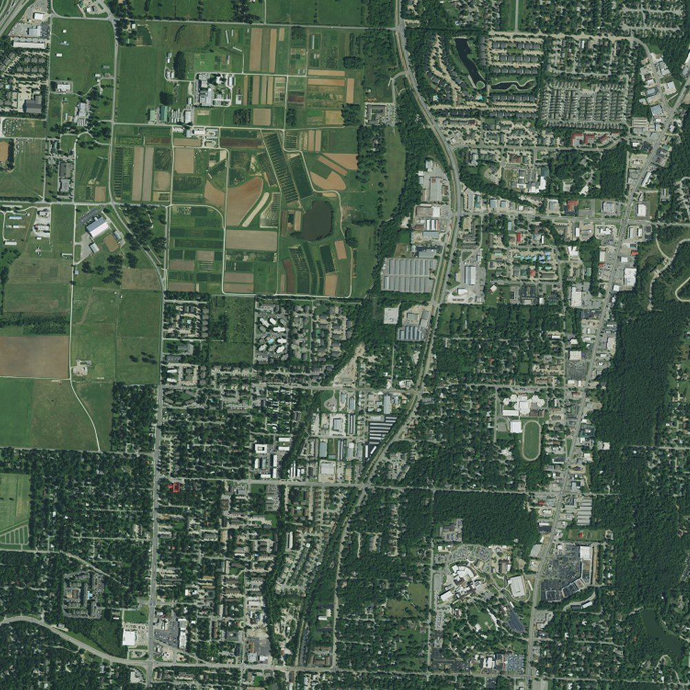
BIASES
The images mostly show agricultural land which would make it harder for a place like New York to use our applications.
The images were only taken in daylight and clear weather.
Notes:
Adrian
As Stated in the previous slides our images were taken in Washington county from 2006 to 2020. The images mostly show agricultural land which would make it harder for a place like New York to use our applications.
Due to the great majority of geo referenced publically available data being of this form, all picture sets included are from clear weather, daylight flights.

Slide 16

METRICS USED
LOSS: For our loss function, we used categorical cross-entropy.
ERROR: We were able to track our error by tracking the RMSE
ACCURACY: Since we are trying to create and optimize image classification models, we decided to use categorical accuracy from keras optimizers.
PARAMETERS: 7e-4 initial learning rate, 5 epochs, WaCo2015 used validation set
Notes:
Santi

Slide 17
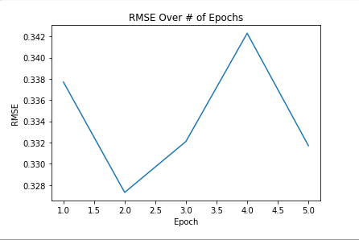
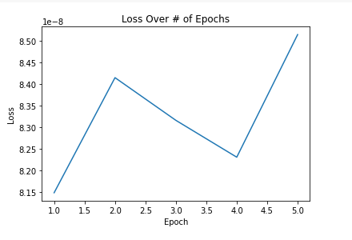
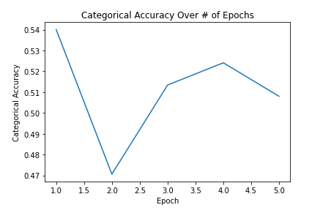
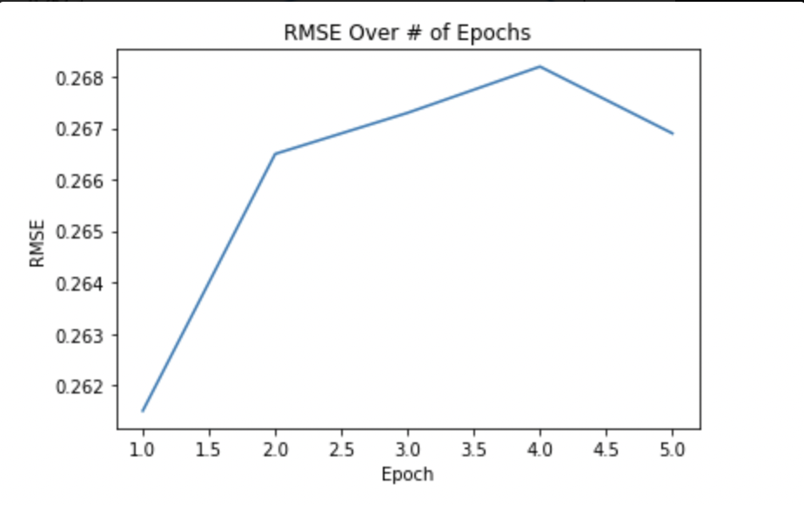
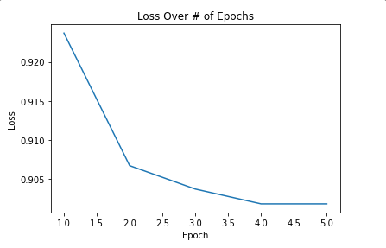
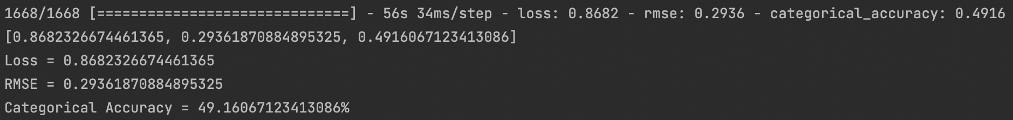
RESULTS
Training RMSE Per Epoch
Training Loss Per Epoch
Model Evaluations
Vision Transformer
Vision Transformer
Vision Transformer
Xception
Xception
Xception
Notes:
Santi

Slide 18
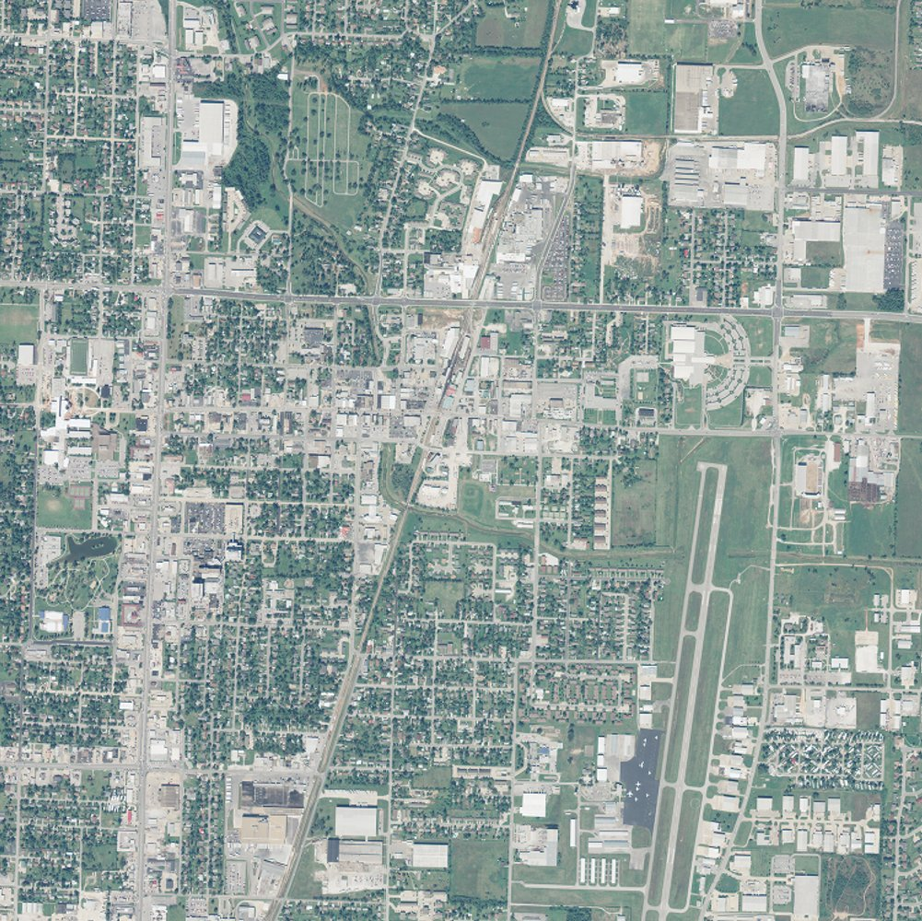
FUTURE APPLICATIONS
Train over various weather condition
Cloud mask preprocessing
Gather more data
High Resolution data
6
3
Notes:
Devin
In future studies it would be beneficial to train our data over various weather condition such as rain and snow.
Also, in our NAIP2009 dataset, we had challenges with cloud covering the region, thus developing a method to mask the cloud as a preprocessing step before training will significantly increase accuracy.
To conclude, Training data outside of Washington County to have an more abroad dataset.

Slide 19

ETHICAL CONSIDERATIONS
Data
Decreased Human Factor
Unemployment due to automation
Notes:
The increased use of drones creates concerns over violations of personal privacy, as the drone owner can access the camera footage which takes images and records people as the drone flies overhead (4).
Another thing that would need to be considered, is in terms of data sets and where they’re sourced from to make sure that this can be accurately used in GPS-denied situations
While some scenarios for drone usage is benign, such as in use for delivering parcels or food, these devices can be used for surveillance and military tasks. While this project is only focused on the navigation of the drone, when considering ethics, future applications of the project should be considered as automated decisions might not always be the most ethical

Slide 20
REFERENCES
Spyros GeorgilidakisSpyros Georgilidakis has degrees in Business Enterprise and Management. He has 14 years of experience in the hospitality and travel industries. (2021, September 27). NavGuard – Drone Navigation without GPS! Mentour Pilot. Retrieved July 28, 2022, from https://mentourpilot.com/navguard-drone-navigation-without-gps/
Visual localization. Papers With Code. (n.d.). Retrieved July 28, 2022, from https://paperswithcode.com/task/visual-localization
Couturier, A., &amp; Akhloufi, M. A. (2020, October 13). A Review on Absolute Visual Localization for UAV. Robotics and Autonomous Systems. Retrieved July 28, 2022, from https://www.sciencedirect.com/science/article/pii/S0921889020305066
The Ethical Debate on Drones - Augustana College. (n.d.). Retrieved July 28, 2022, from https://digitalcommons.augustana.edu/cgi/viewcontent.cgi?article=1008&amp;context=ethicscontest
Chollet, F. (2017). Xception: Deep learning with depthwise separable convolutions. 2017 IEEE Conference on Computer Vision and Pattern Recognition (CVPR). https://doi.org/10.1109/cvpr.2017.195

Slide 21
Acknowledgements
Special thanks to:
NACME and Google
The University of Arkansas
Michele Lezama
Dr. Chase Rainwater (Advisor)
Winthrop Harvey (TA)
Dr. Bryan Hill
Teresa Simpson
As well as any other professors and TAs who made this possible.
Notes:
Santi

Slide 22
Does anyone have any questions?
Notes:
Ayia

Slide 23

THANK YOU!
Follow us on LinkedIn!
Notes:
Ayia

